Slide 1
004 (1)
Process
Technology
Team 3 (Sanjib Tamang)

Slide 2
Contents
Introduction
Project Objective
Hardware Architecture
System Structure Overview
Approach to the project

Slide 3
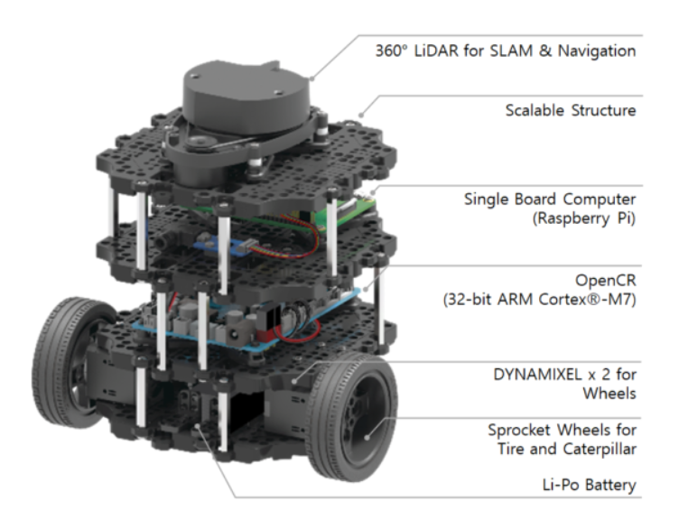
Introduction
A modern mobile robot that is modular, portable, and adaptable is the TurtleBot3 Burger.
Major Sensors and Actuators used are shown aside in the image.

Slide 4
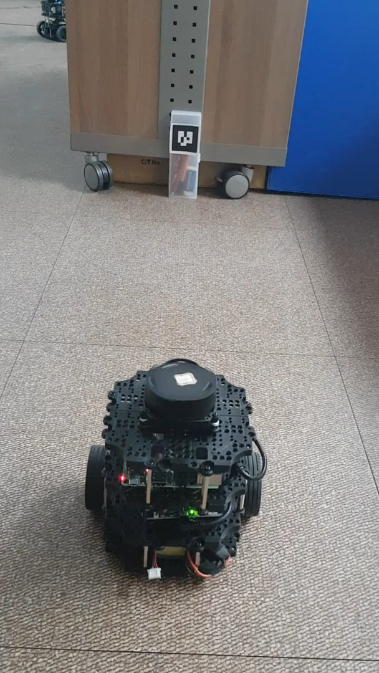
Project Objective
The major goal of our project is to enable the Turtlebot3 to operate in autonomous driving mode that includes obstacle recognition and traffic sign detection using ROS.

Slide 5
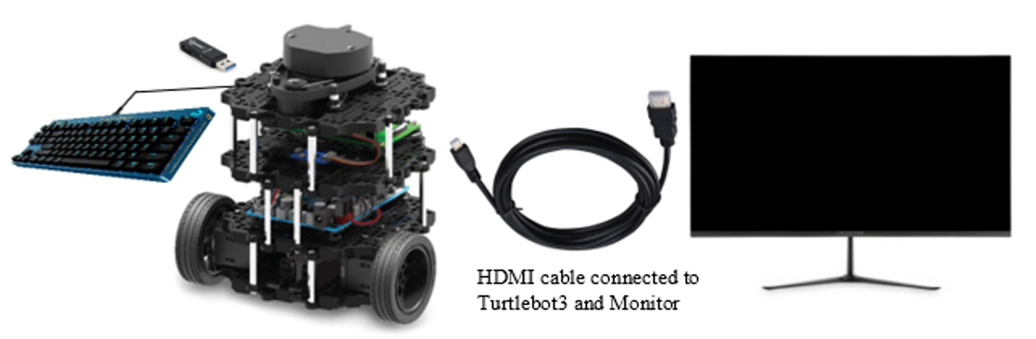
Hardware Architecture

Slide 6
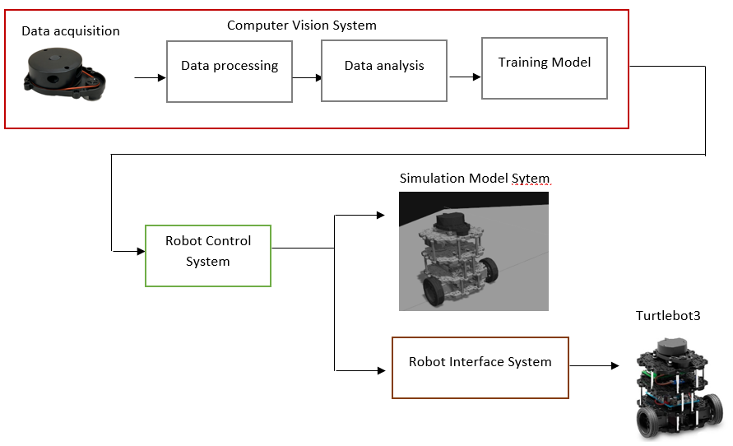
System
Structure
Overview
reference : https://www.researchgate.net/publication/335505212_Vision_Based_Control_for_Industrial_Robots

Slide 7

Approach to the project

Slide 8
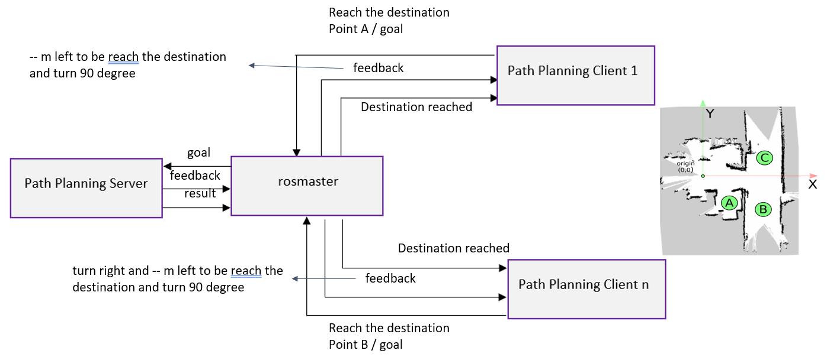
ROS: Navigation, Path planning and Action Interface
reference : https://wiki.nps.edu/pages/viewpage.action?pageId=1157791916

Slide 9
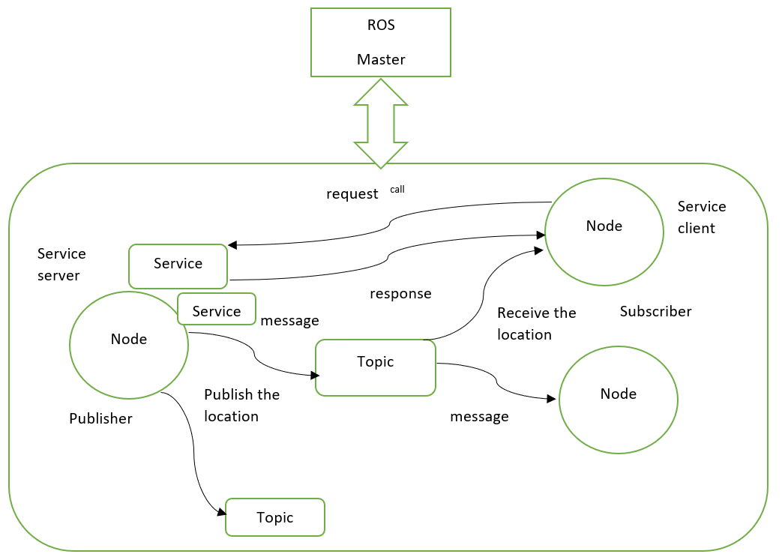
ROS: Navigation, Path planning and Action Interface
reference:
http://akihikoy.net/notes/?text%2FROS%2FMinOverview

Slide 10
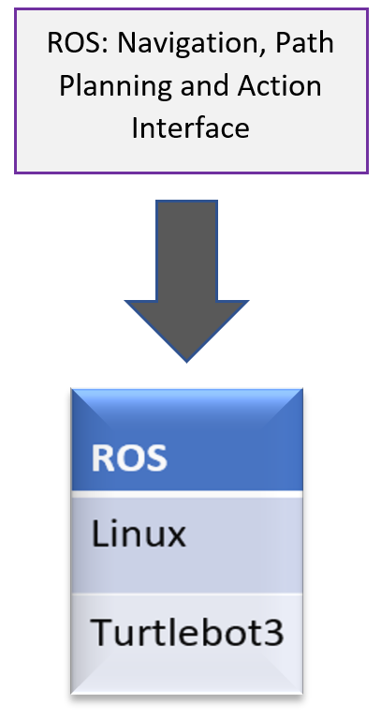
Experiment environment

Slide 11
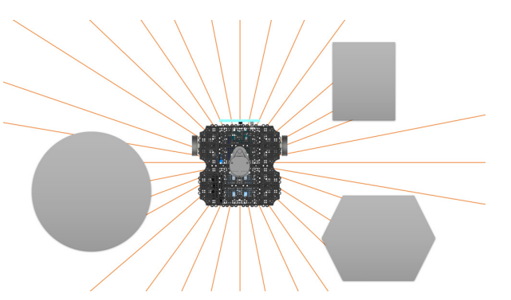
Utilizing LDS
SLAM (Simultaneous Localization And Mapping) is one of the most well-known applications of LDS. SLAM constructs a map by identifying barriers around the robot and estimating the robot's present position within the map as demonstrated in figure.
Obstacle detection of a robot using LDS

Slide 12
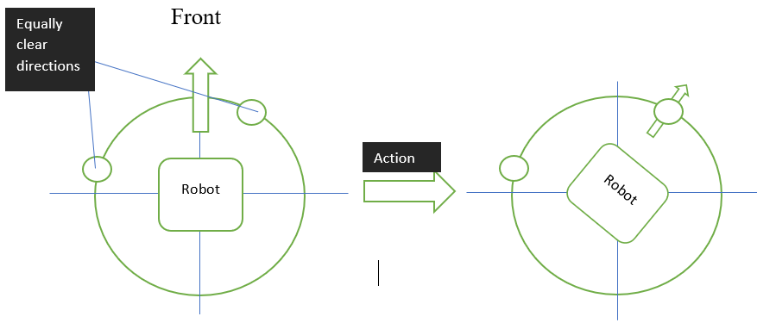
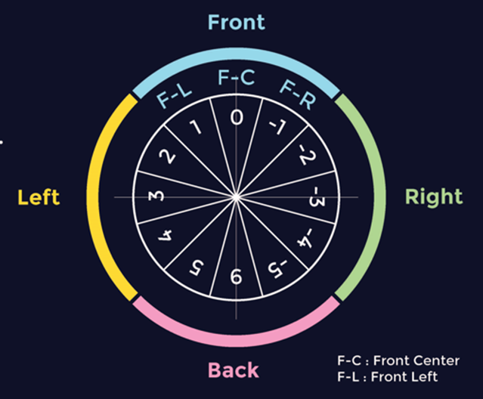
Utilizing LDS
Goal
Position the robot's front such that it faces the path that is the cleanest and produces the fewest detours.
Data processing
LiDAR technology offers 360-degree coverage. Four global areas made up of three local regions each make up the covered circle.
Each sub-integers region's represent the weight of the goal deviance (F-C). Each integer's sign specifies the robot's orientation with respect to the target (F-C).

Slide 13
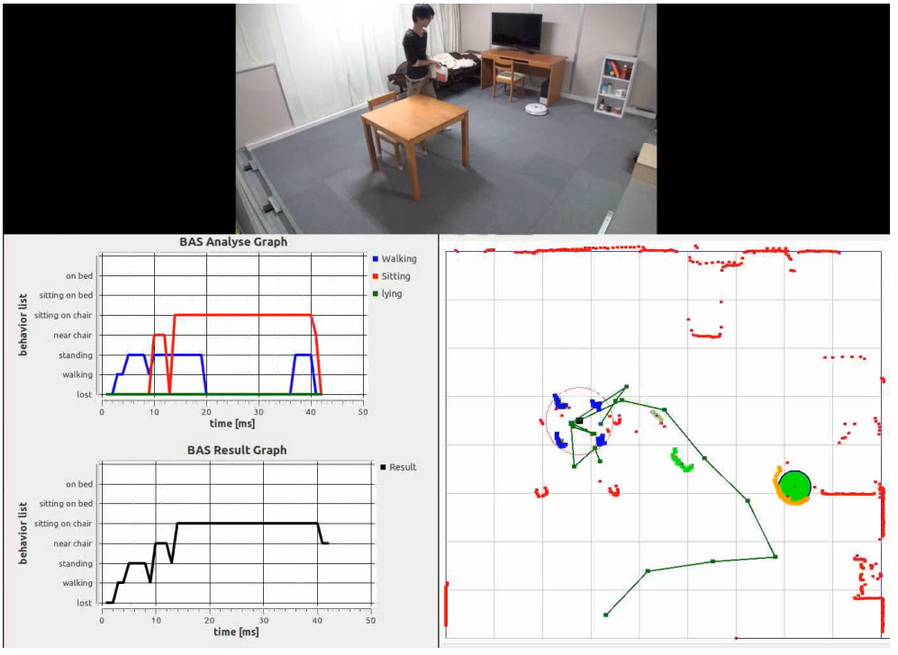
Utilizing LDS
Detecting people and moving objects using LDS

Slide 14
Flow-chart of obstacle detection by Lidar sensor
START
INPUT (emits radiation by Lidar sensor)
Receive the information
Data processing
Detection of obstacle
Yes
No
Change the path
(left,right or backwards)
Follow the same path
reference : https://www.irjet.net/archives/V4/i2/IRJET-V4I2177.pdf

Slide 15
Proposed Traffic Light System Architecture
Turtlebot3
Raspberry pi camera
Raspberry pi 4
Program development using ROS
Red LEDs Yellow LEDs Green LEDs
Monitor
Keyboard
reference : https://www.researchgate.net/publication/359756848_Raspberry_Pi-Based_Intelligent_Traffic_Signal_Control_at_Intersections

Slide 16
Traffic Sign Detection Architecture
ROS
image acquisition ROS node
robot action detection ROS node
openCR
rosserial
camera
image processing ip
Robot control (velocity, angle)
image
obstacle detection
motor
traffic light detection

